Slide 1


Slide 2
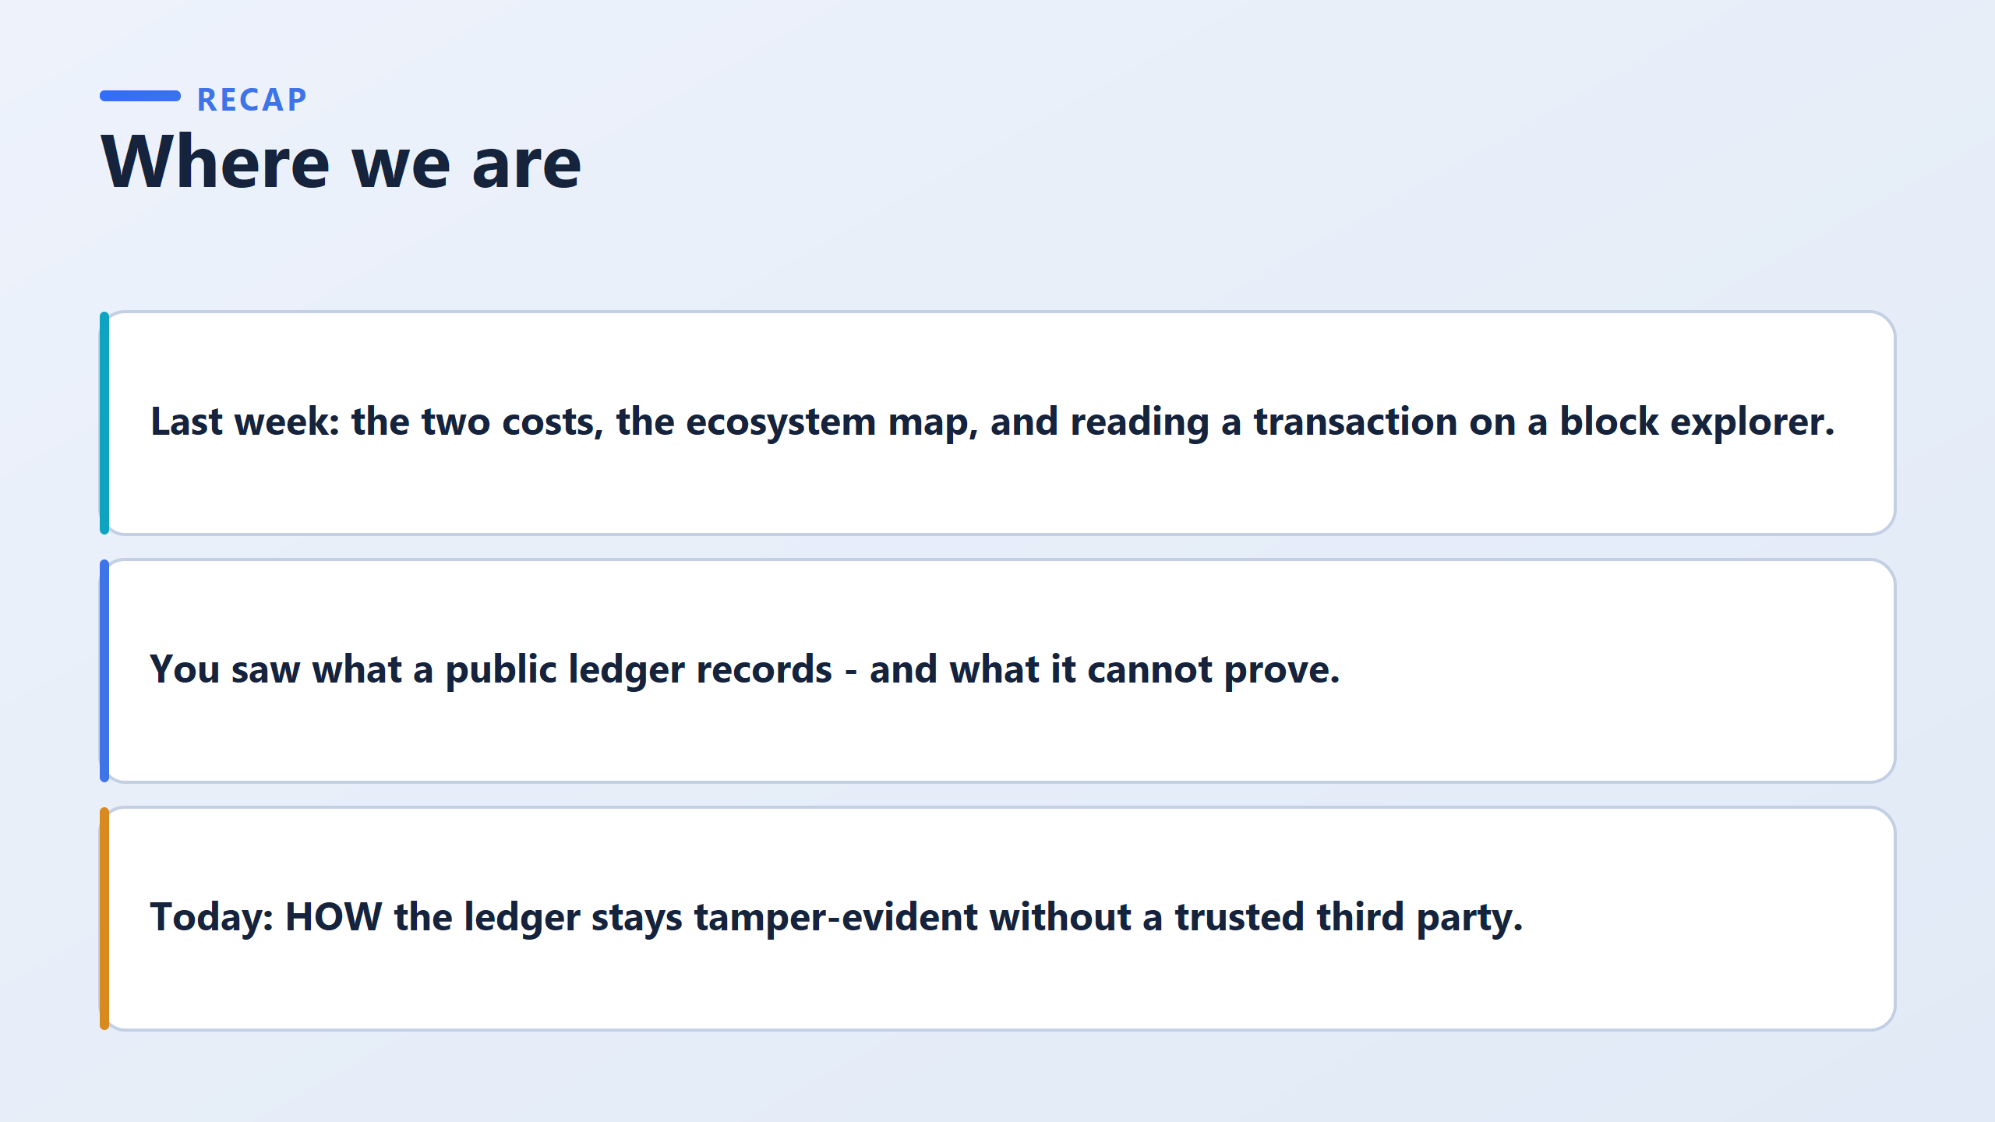
Three tools do the work.
  Hashing detects change.
  Chaining spreads that detection across the whole history.
  Signatures establish who authorised each entry.

Slide 3
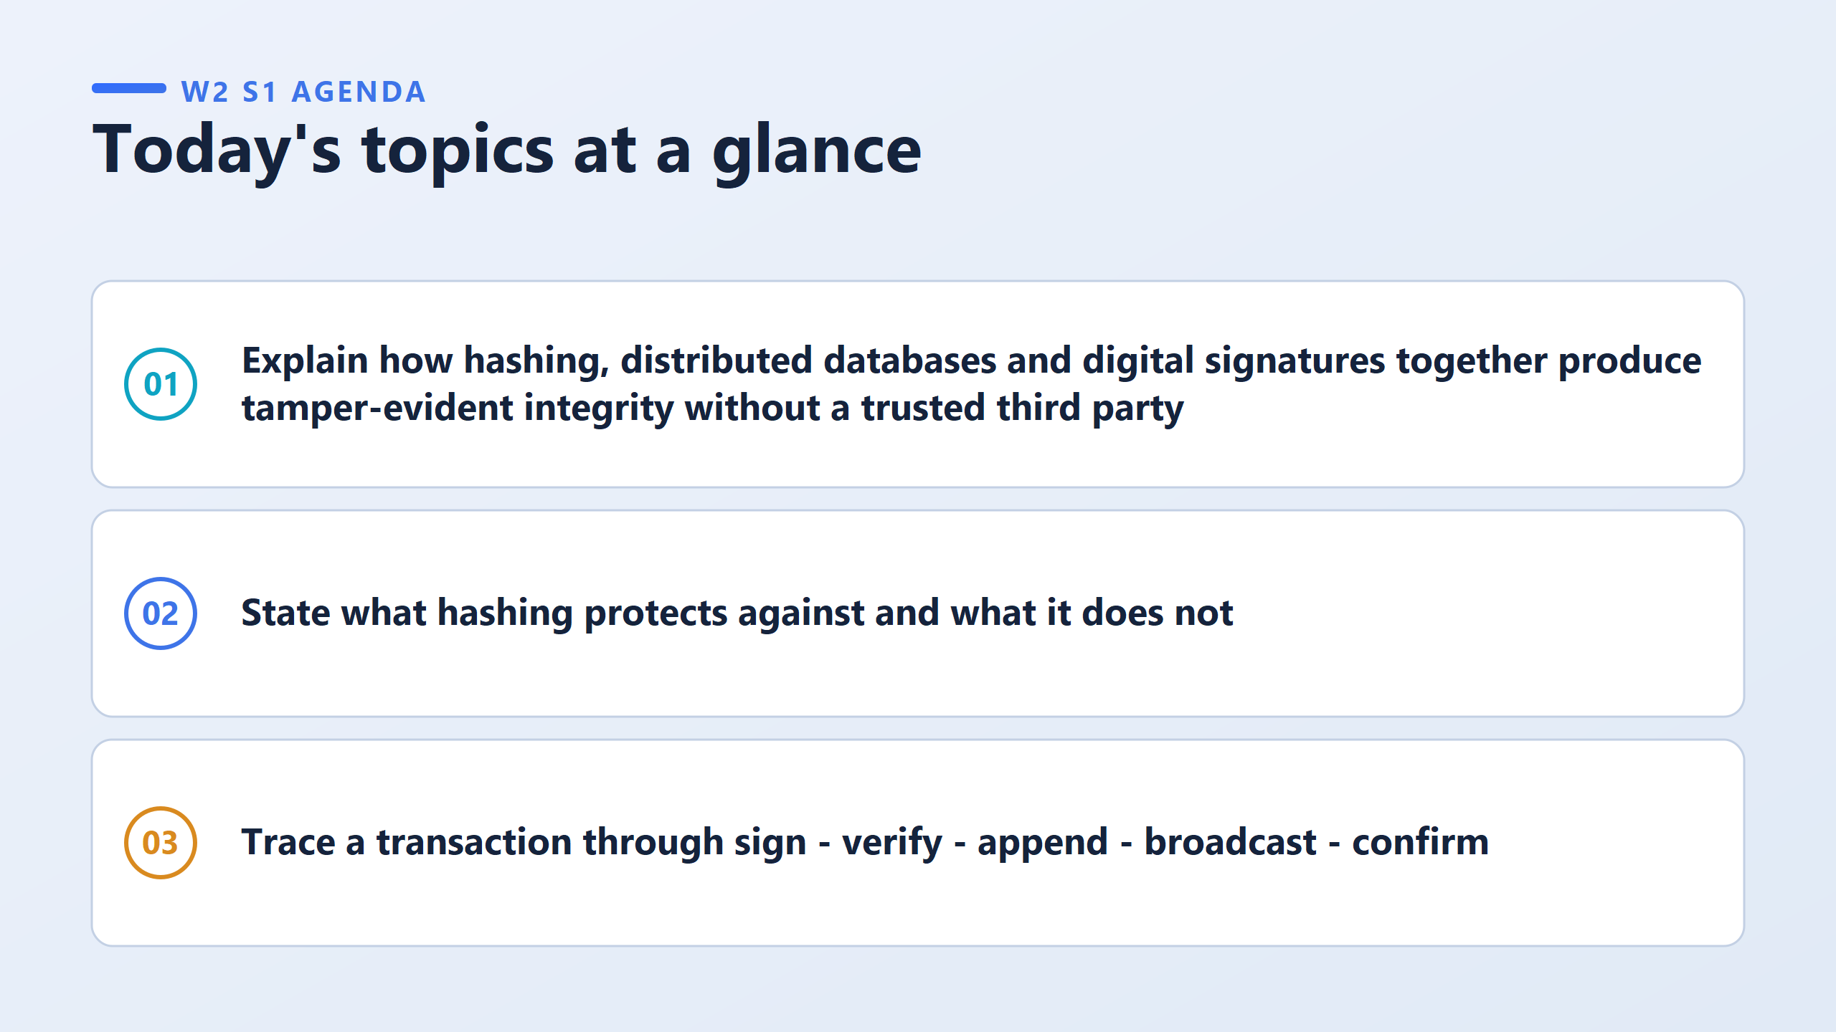

Slide 4
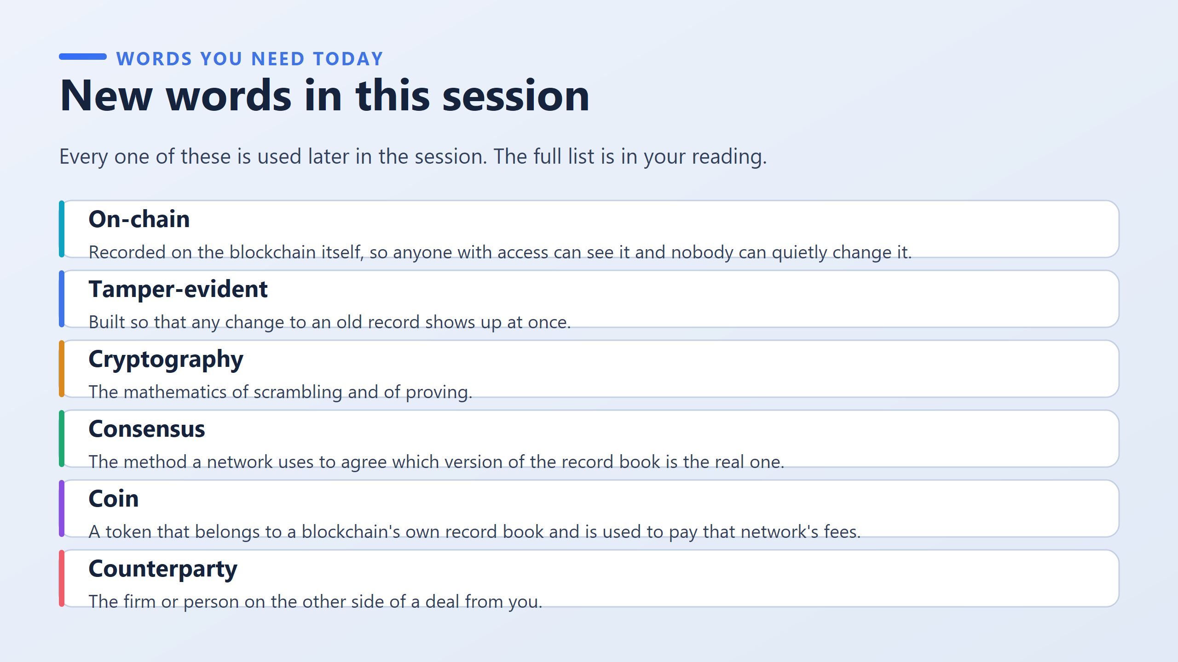
a way for many computers in a blockchain network to agree on which version of the blockchain is valid.
the person or organization you are dealing with.

Slide 5
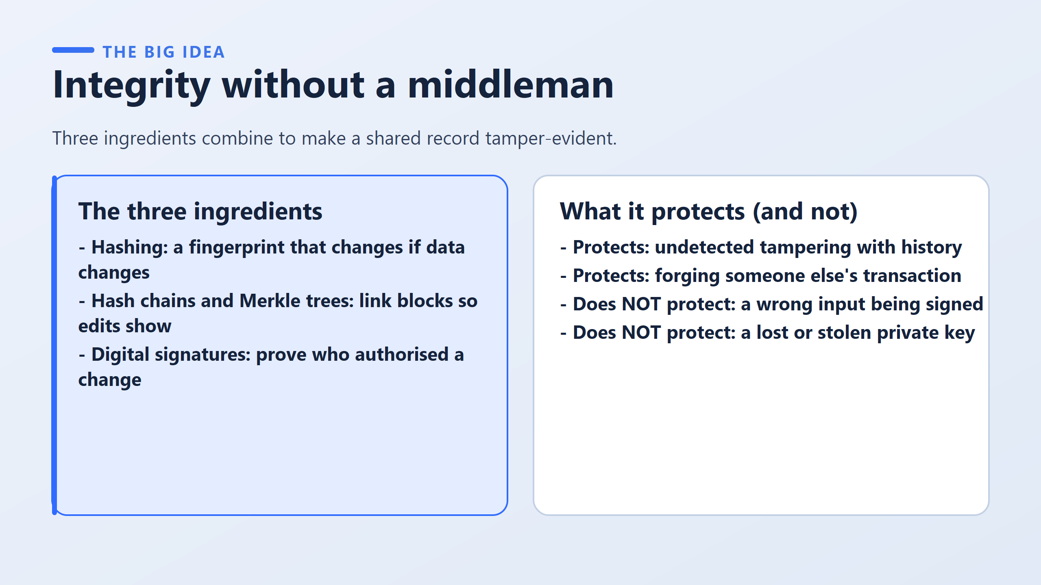

Slide 6
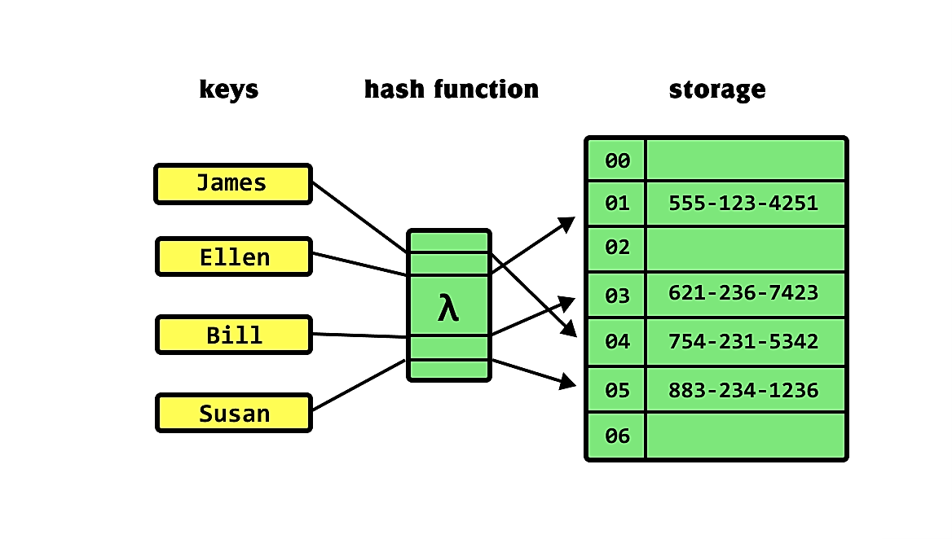
A hash is a fingerprint of a piece of data.
Feed in any text and you get back a short string of fixed length.
The same input always produces the same fingerprint, and any change at all, even one character, produces a completely different one.
That is the detection mechanism.
A hash chain applies that idea to blocks.
Each block carries the fingerprint of the block before it.
So changing an old record changes that block’s fingerprint.
That fingerprint no longer matches what the next block recorded, and the mismatch breaks every link after it.
One quiet edit becomes a visible break running all the way to the present day.
A Merkle tree is the same idea applied inside a single block: many transactions summarised into one fingerprint, so one changed transaction changes the block’s summary.
A digital signature answers a completely different question.
Hashing tells you whether something changed.
It cannot tell you who was allowed to write it in the first place.
Signatures do that, using a private key that only the owner holds.

Slide 7
A Bahraini firm records a property transfer on a shared ledger and types the wrong plot number.
Hashing guarantees that the wrong number will never be silently altered afterwards.
It guarantees nothing at all about the number being right in the first place. Integrity is a promise about the record, never about reality.
Say the pair of words that captures it: faithful, not truthful.
The ledger is faithful to what it was given, and it has no opinion about whether what it was given was true.

Slide 8
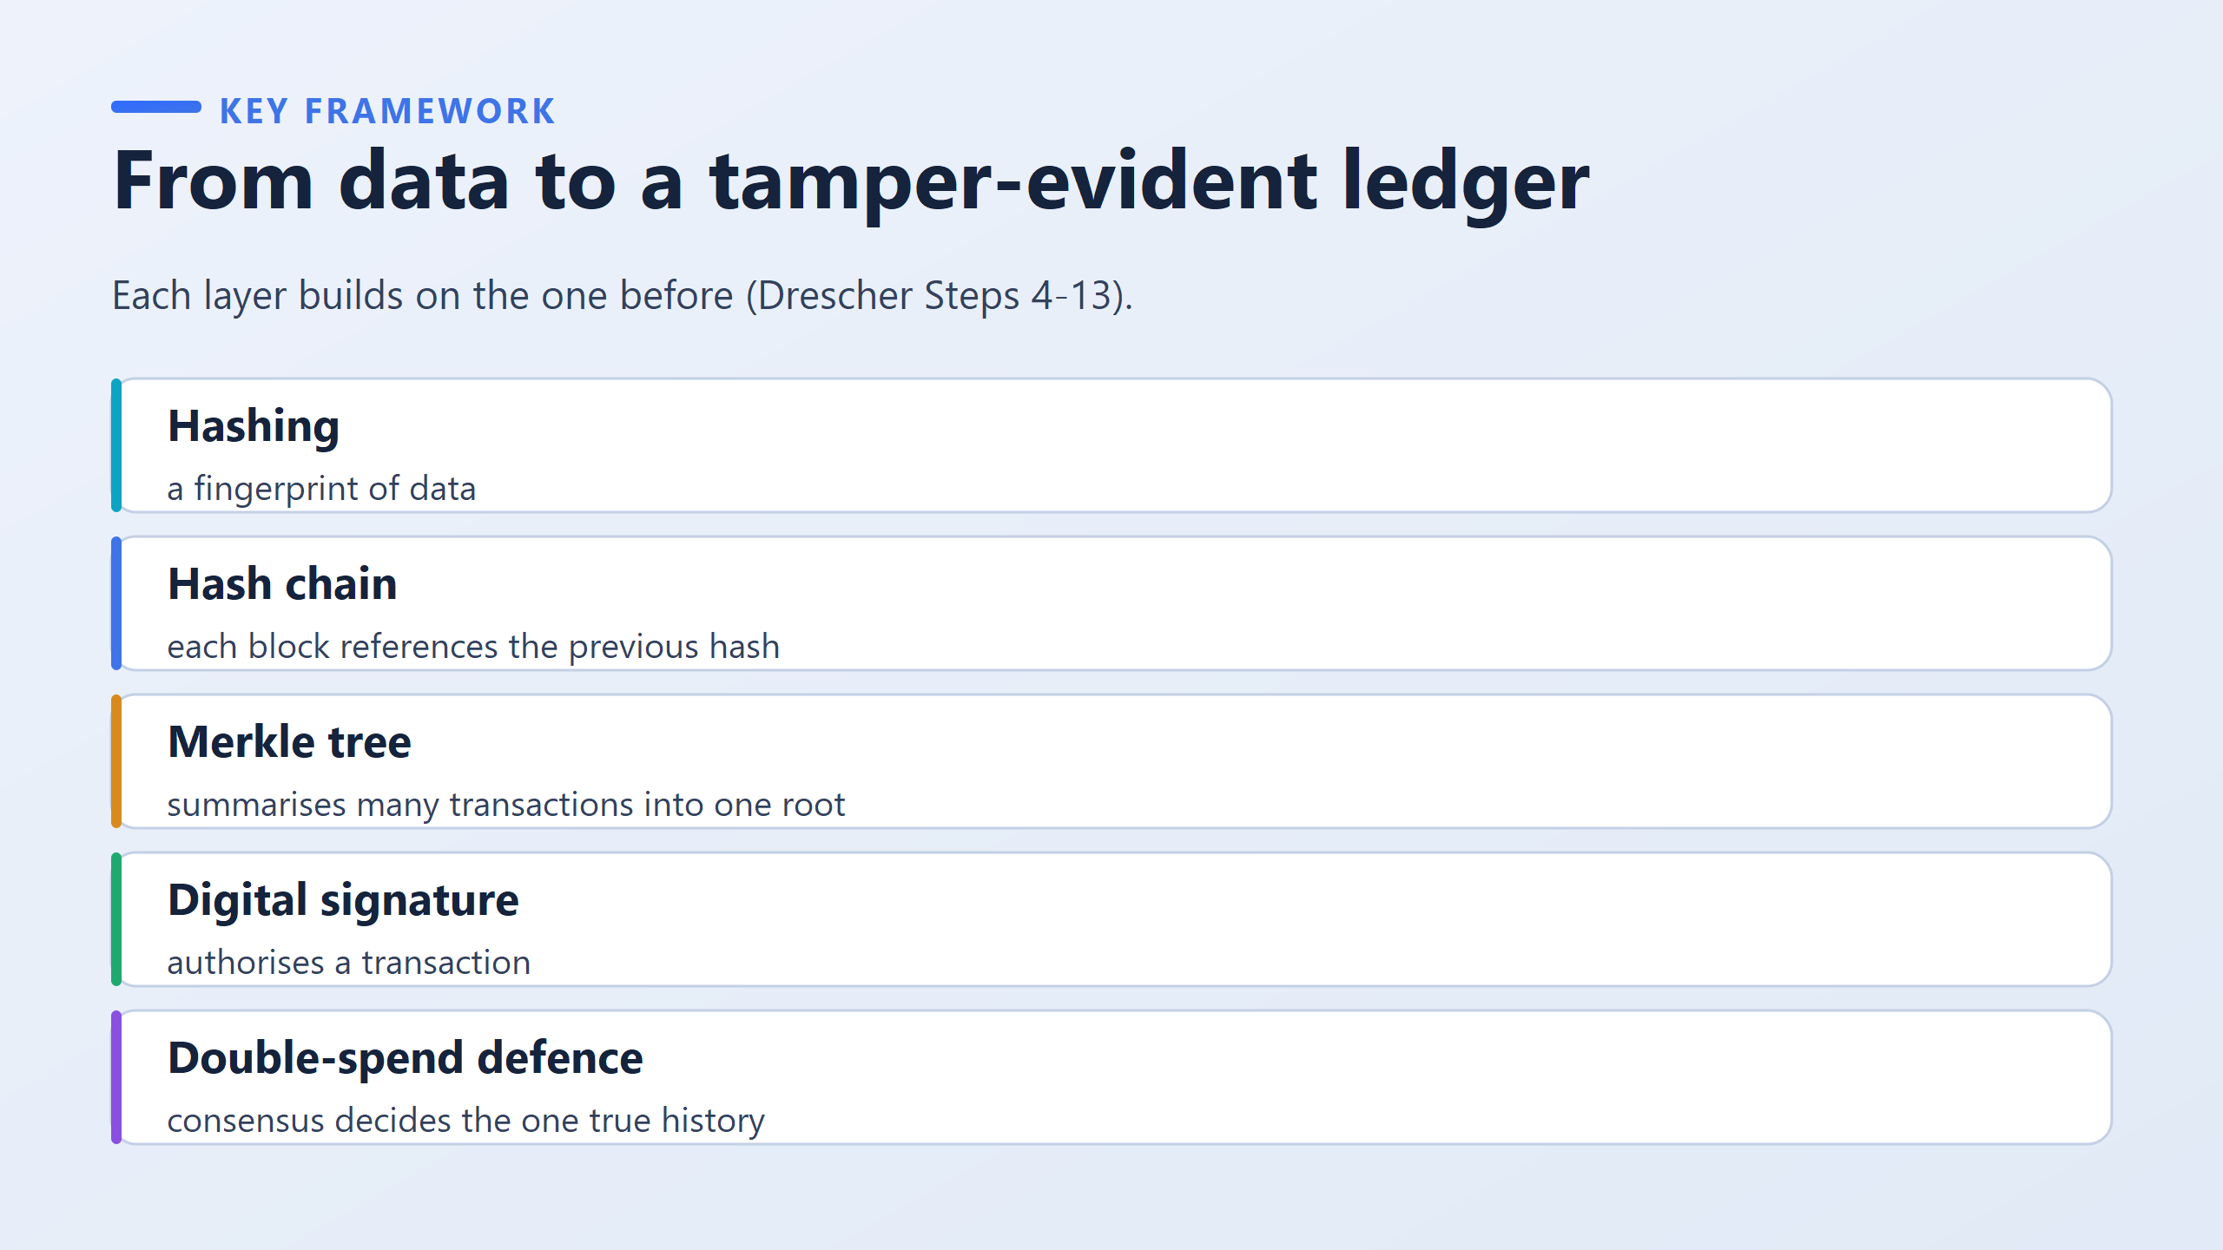

Slide 9
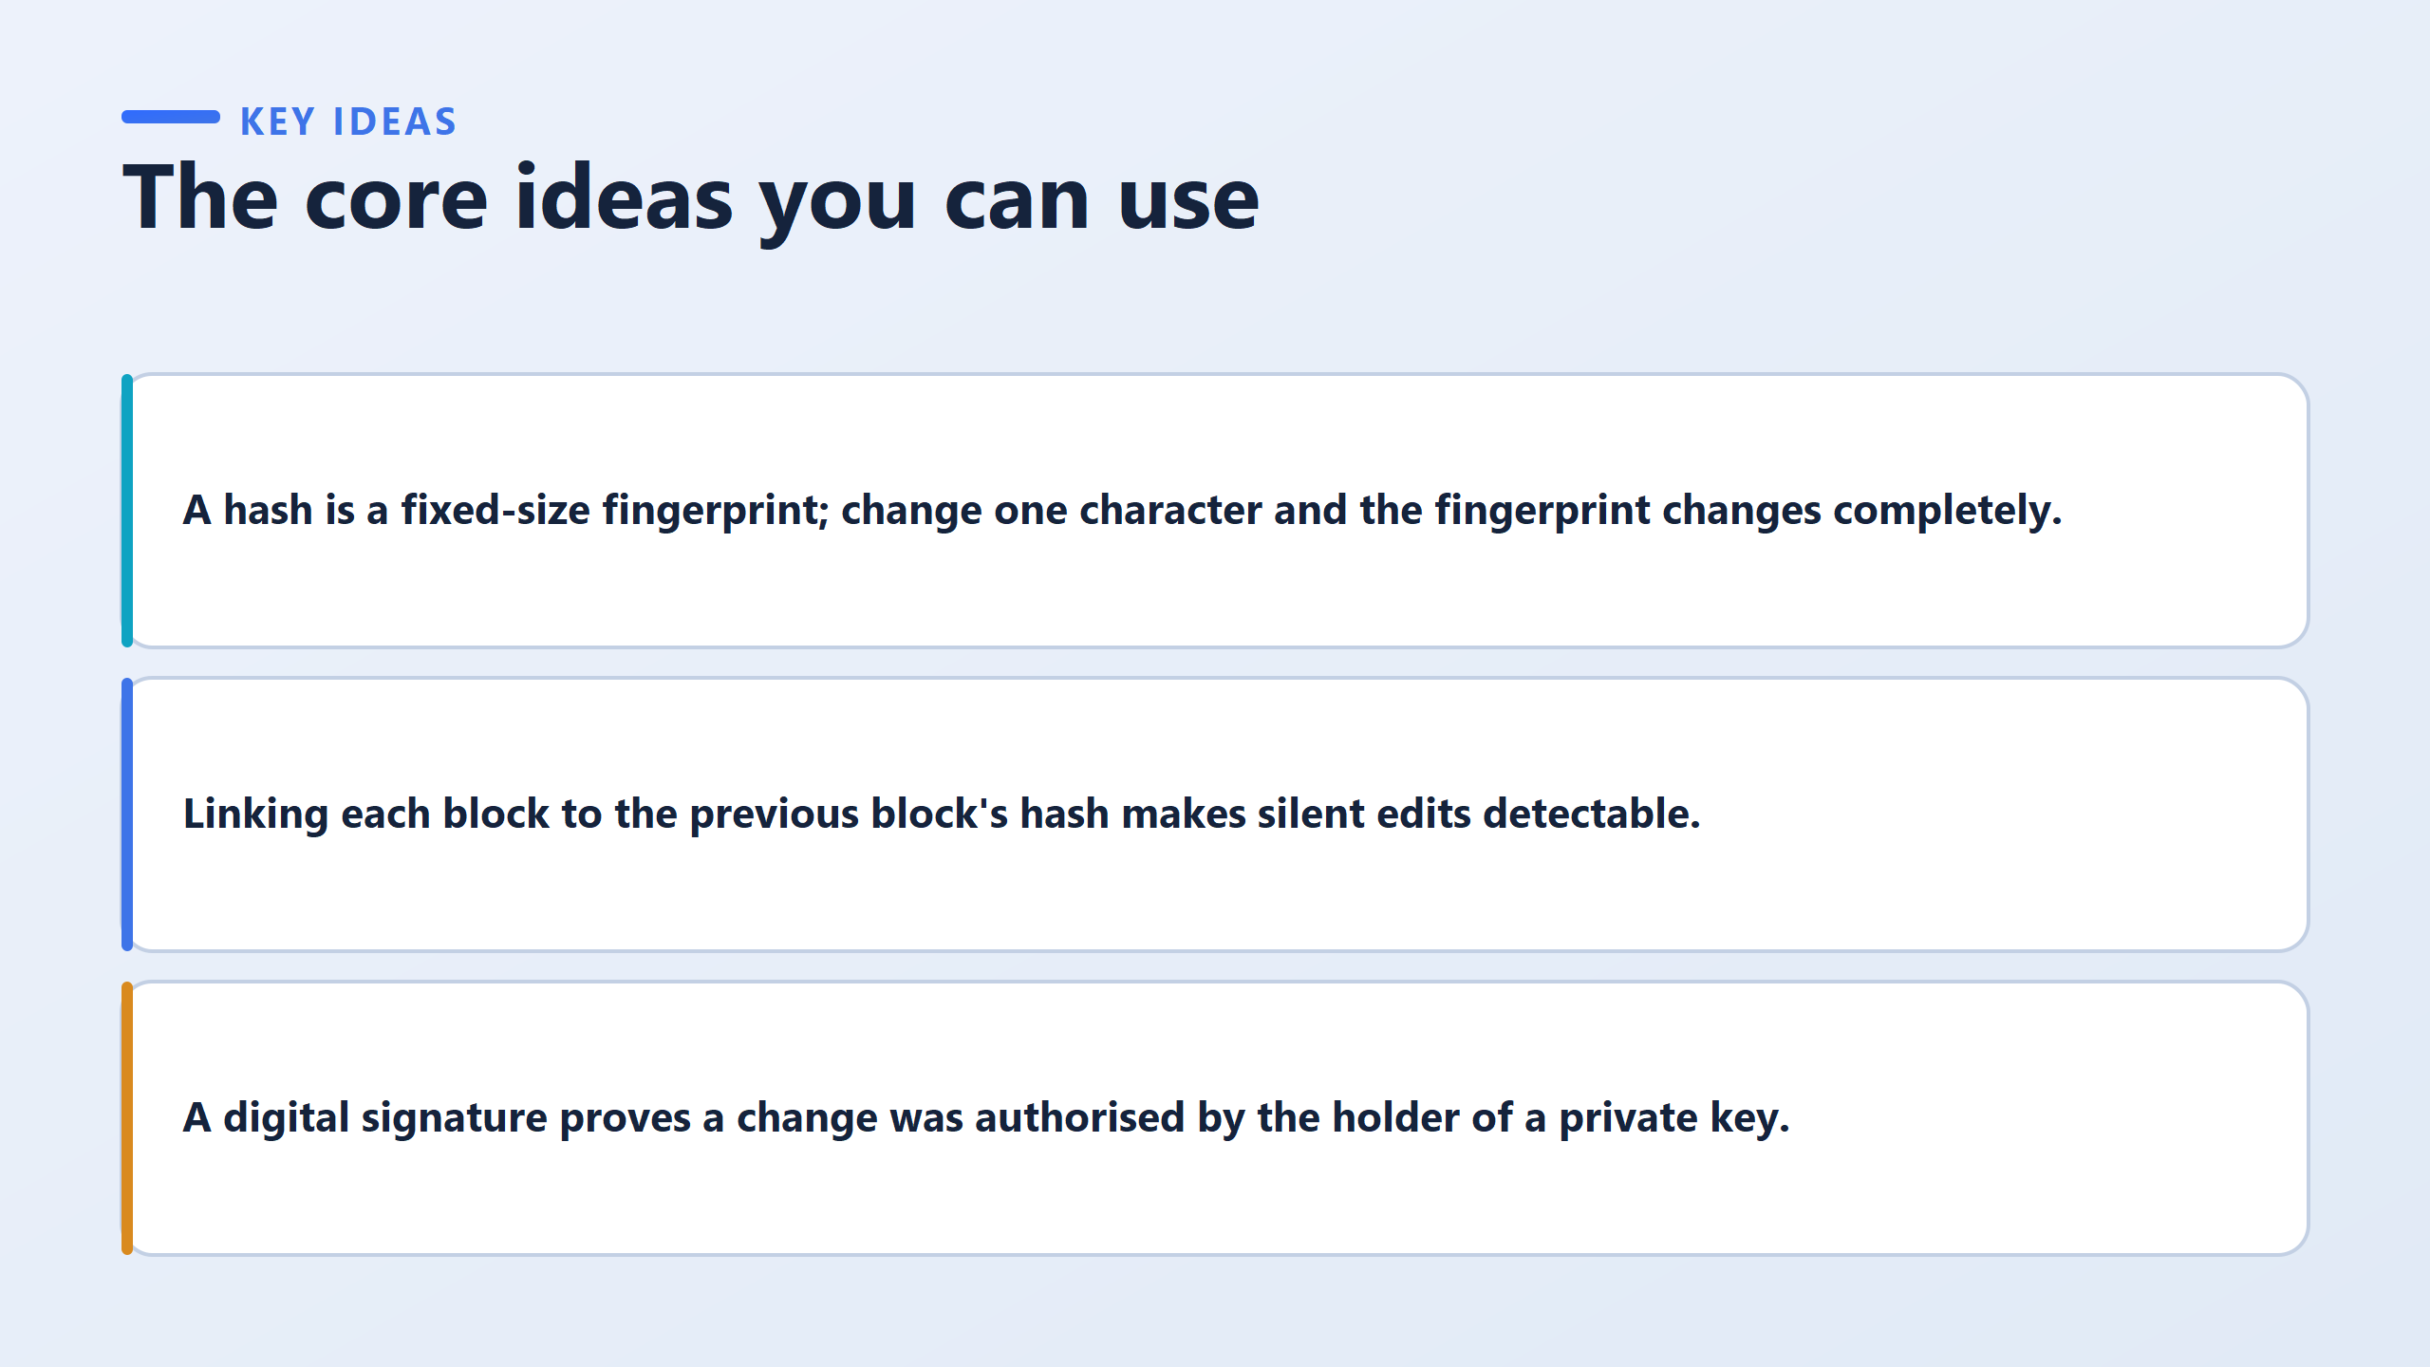
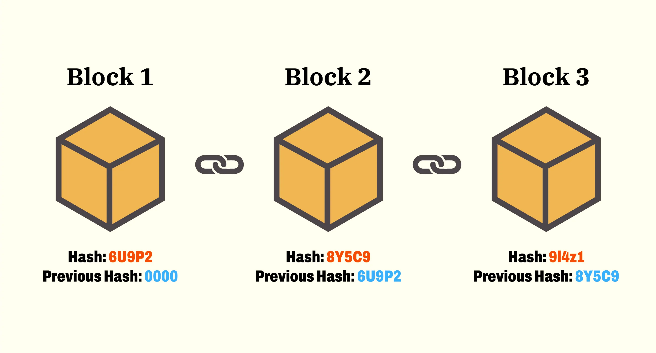
A hash of a single sentence and a hash of an entire contract are the same length. That is what makes fingerprint comparison cheap: you are always comparing two short strings, never two documents.

Slide 10
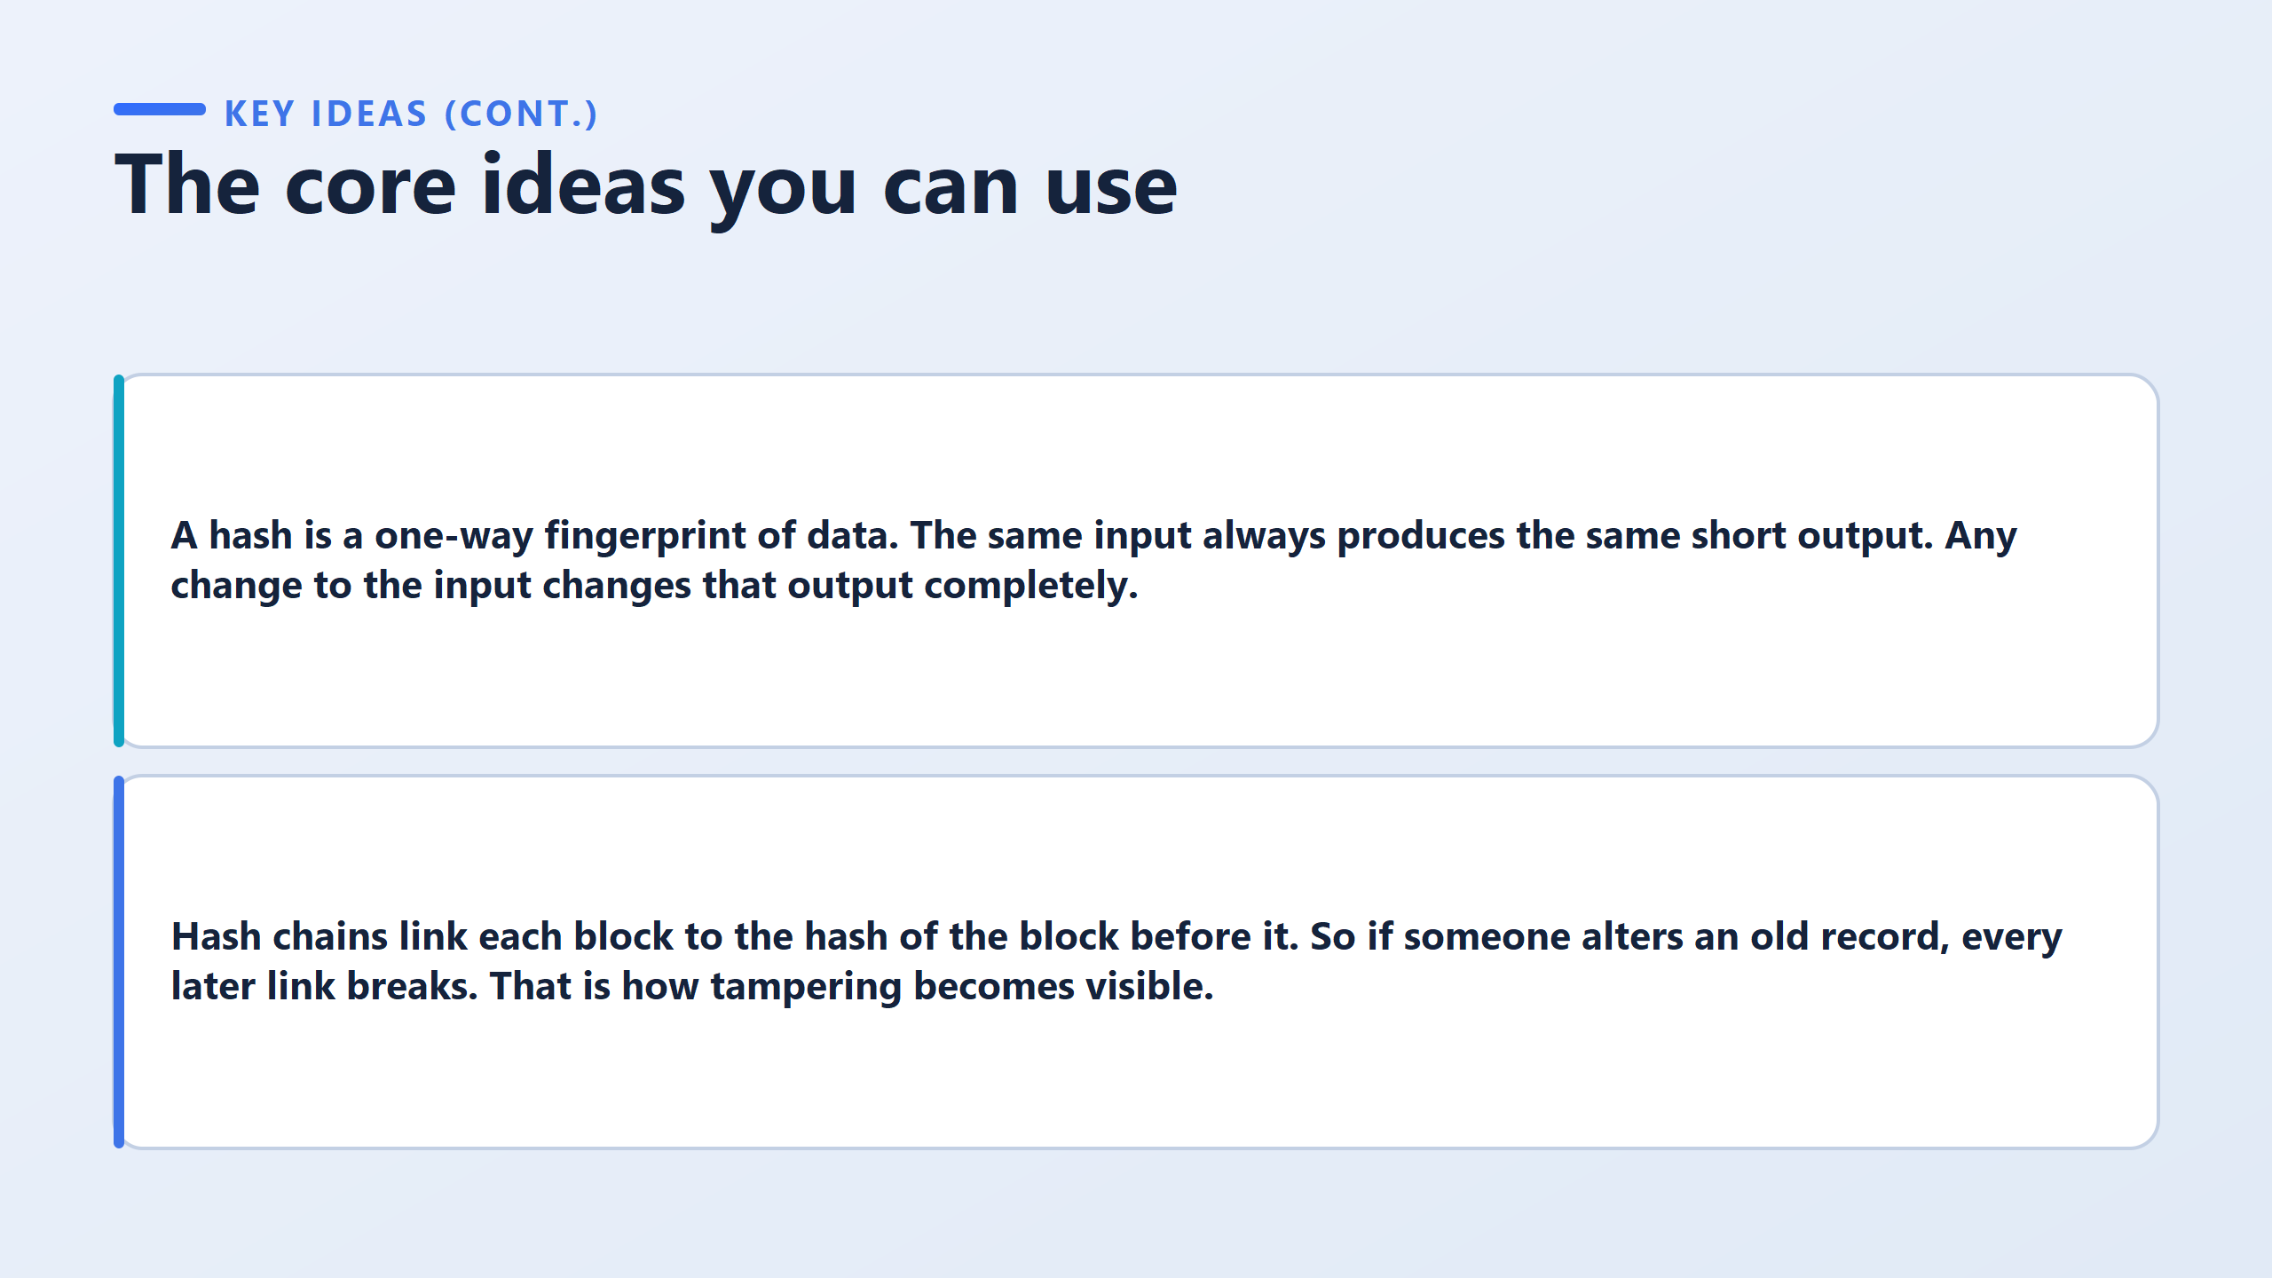

Slide 11
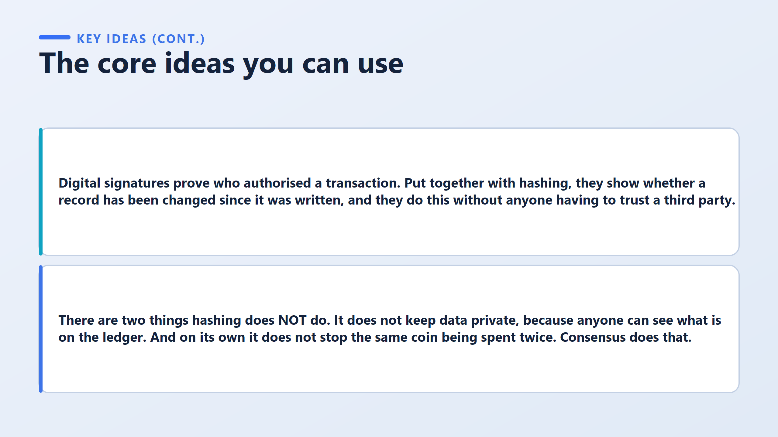

Slide 12
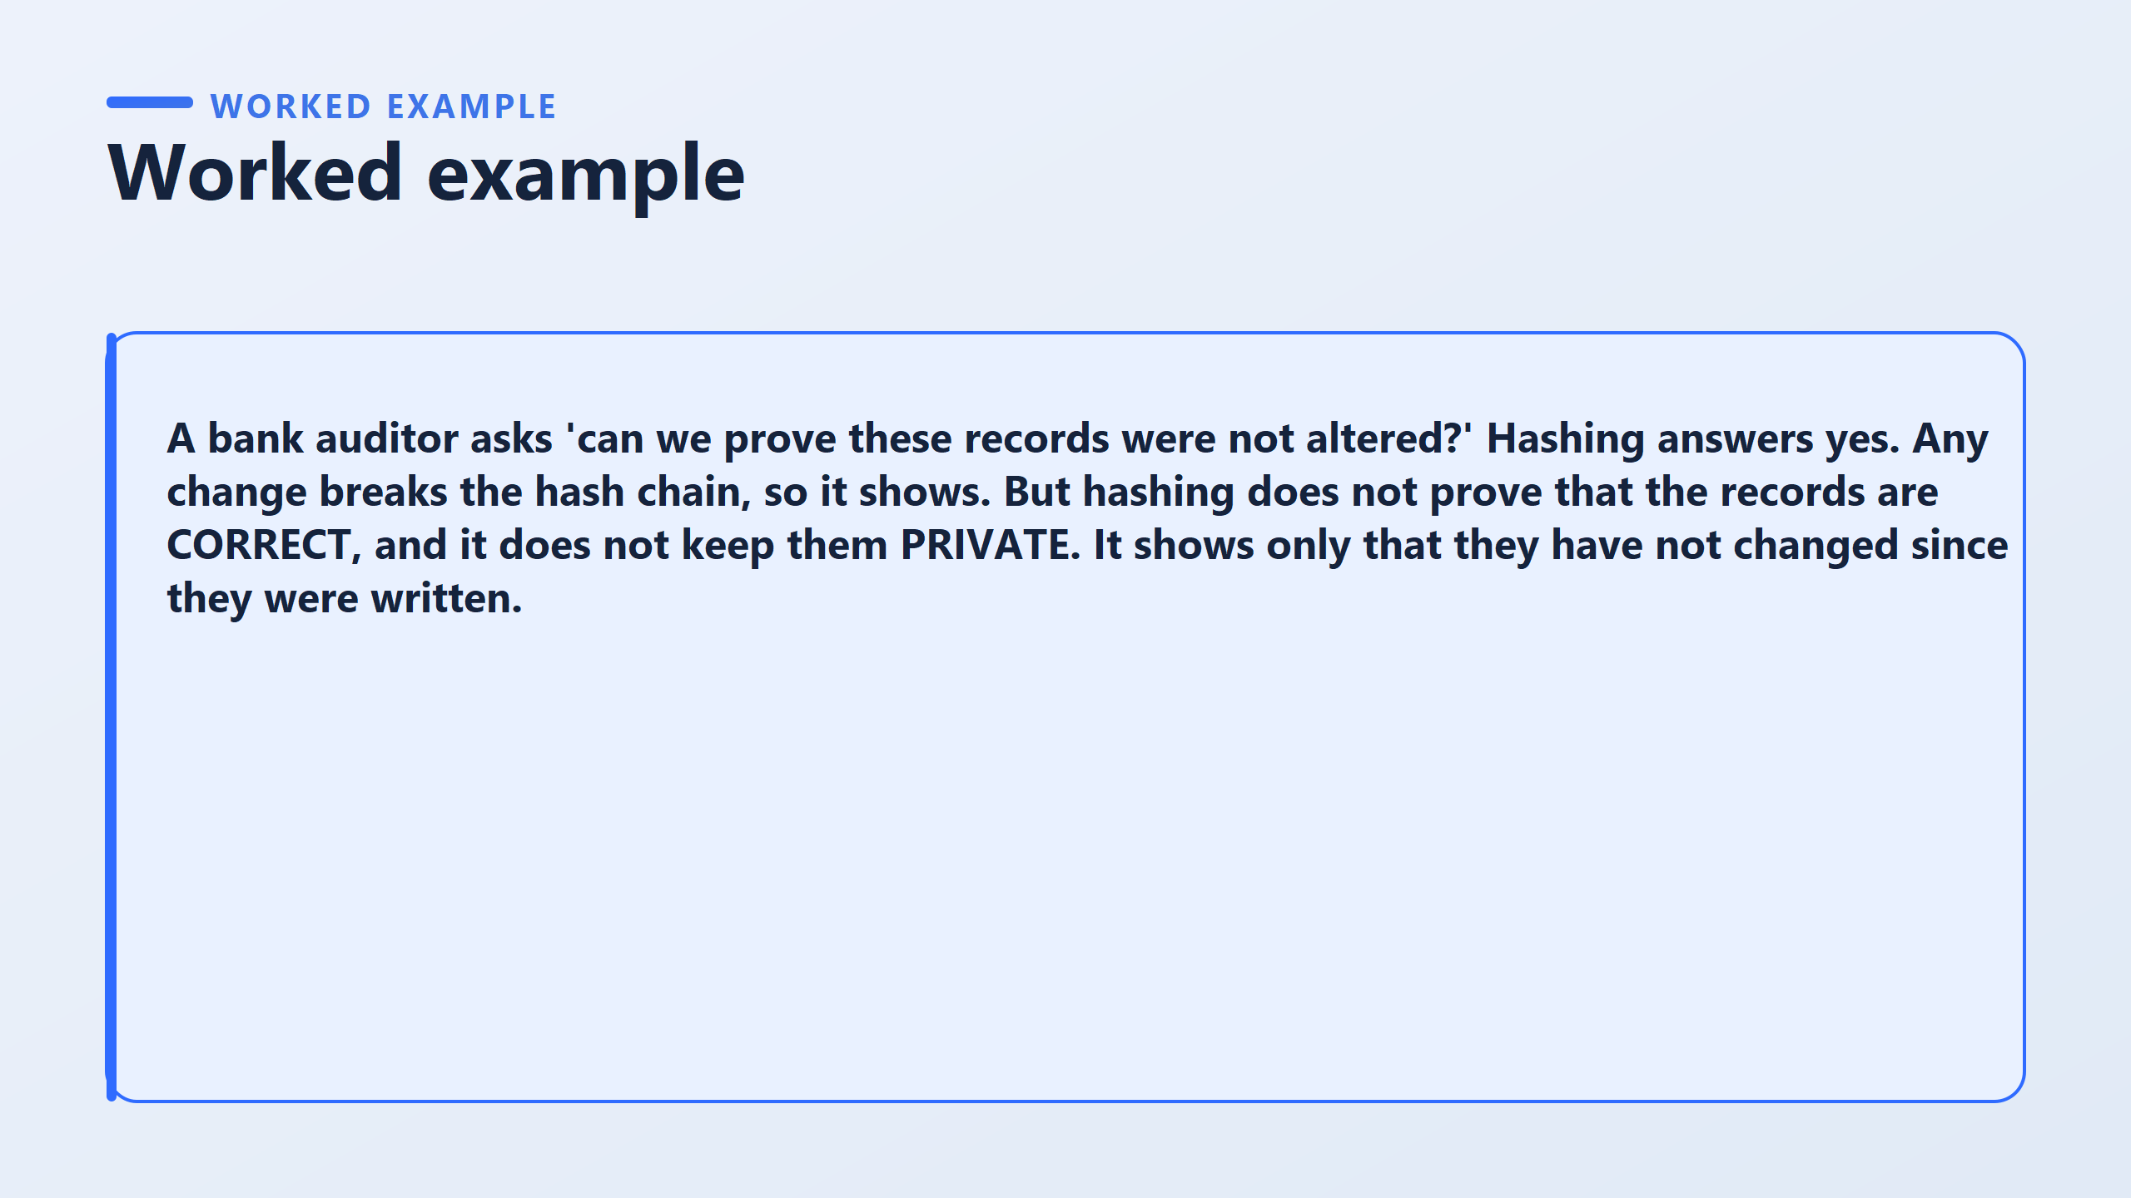

Slide 13
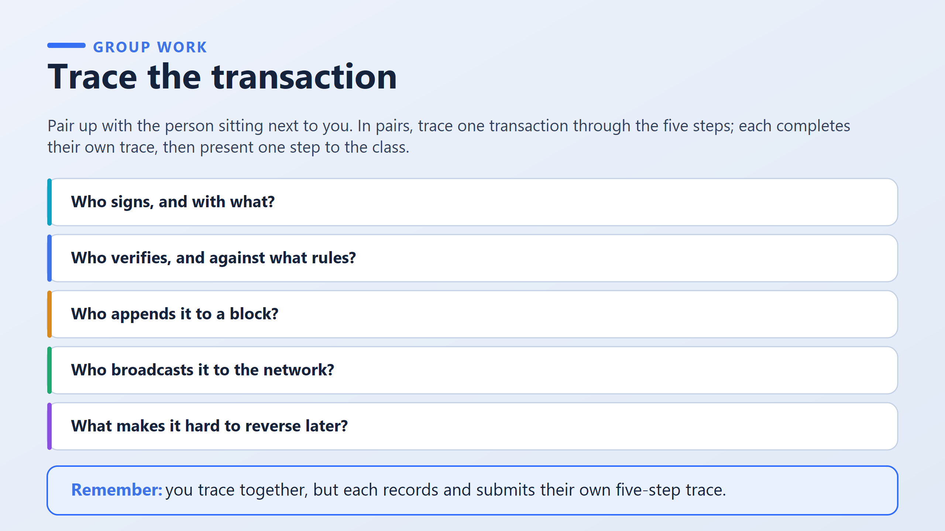

Slide 14
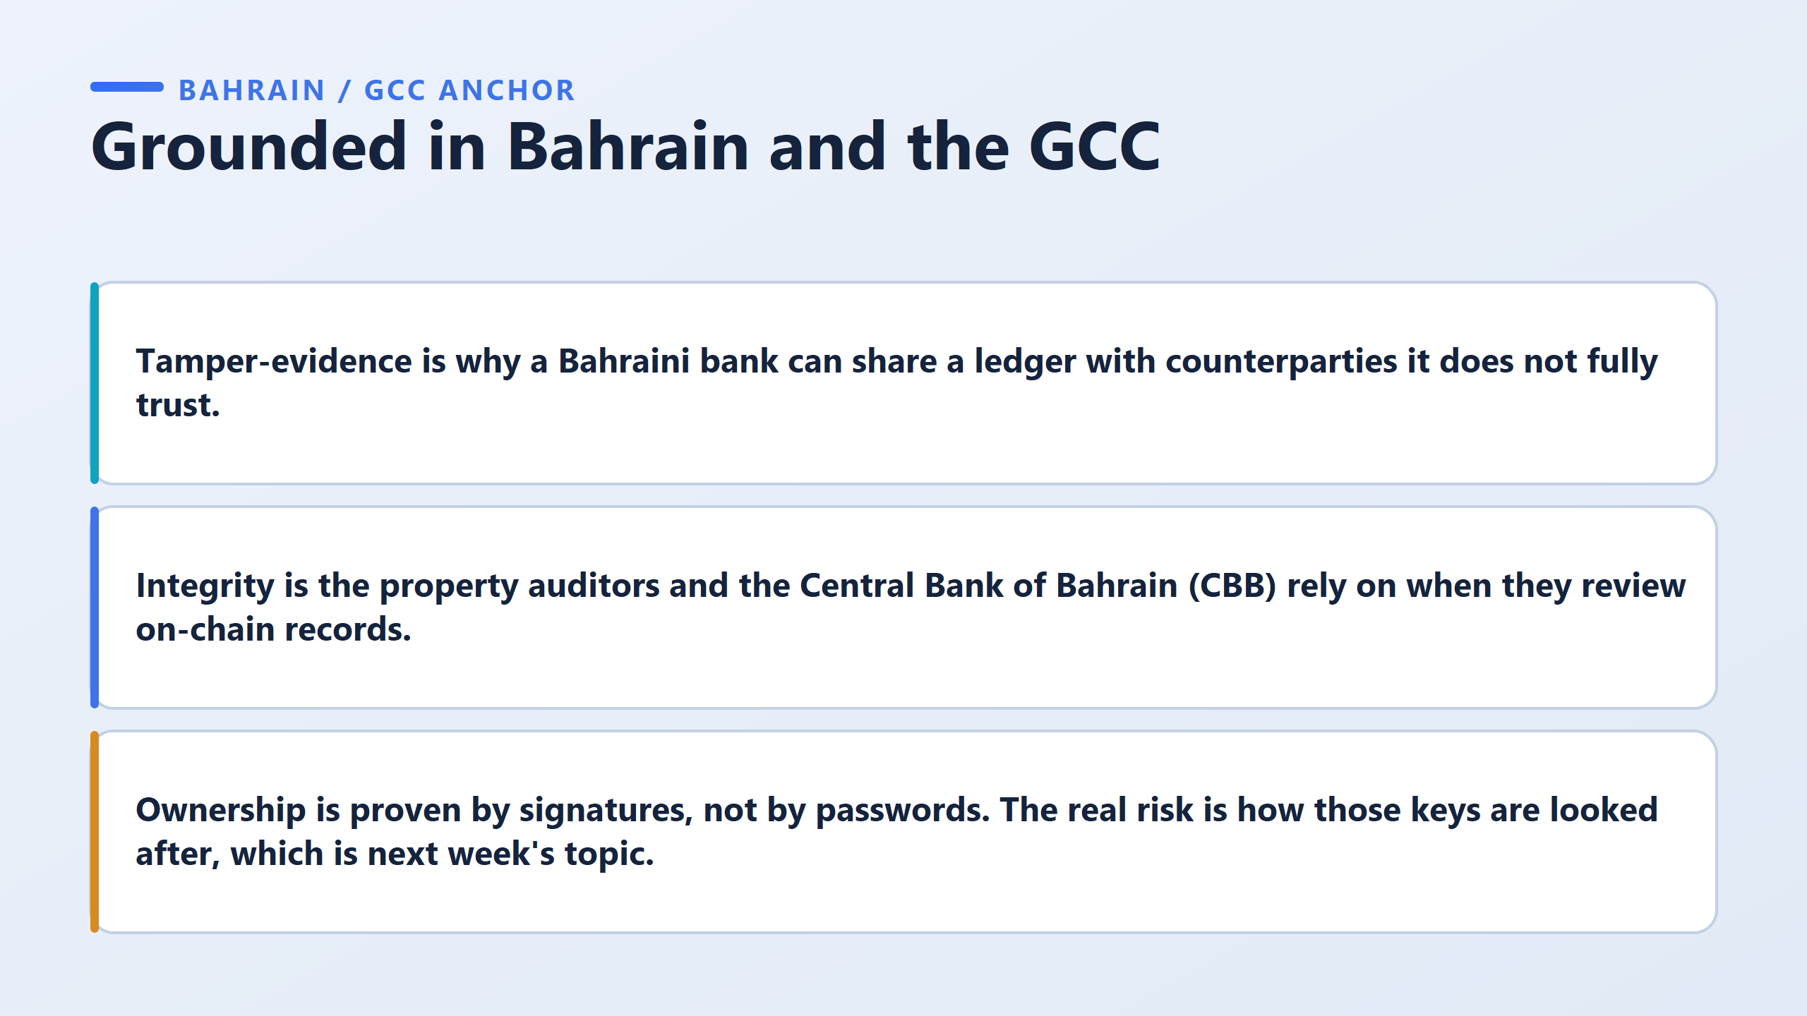

Slide 15
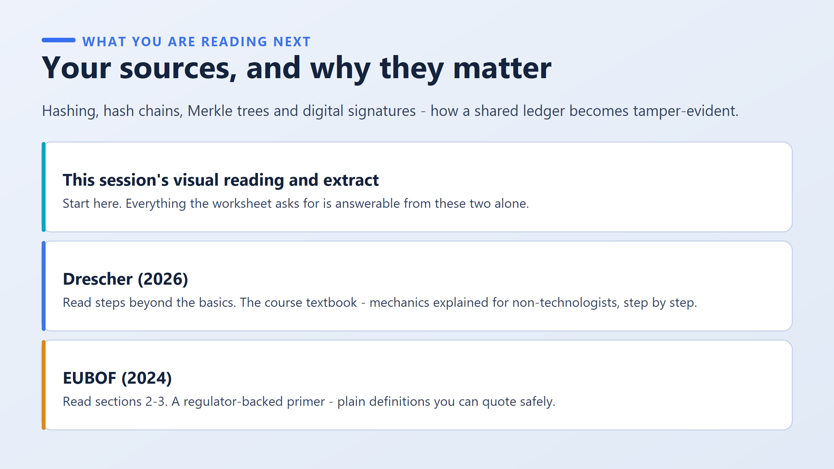

Slide 16
